Slide 1
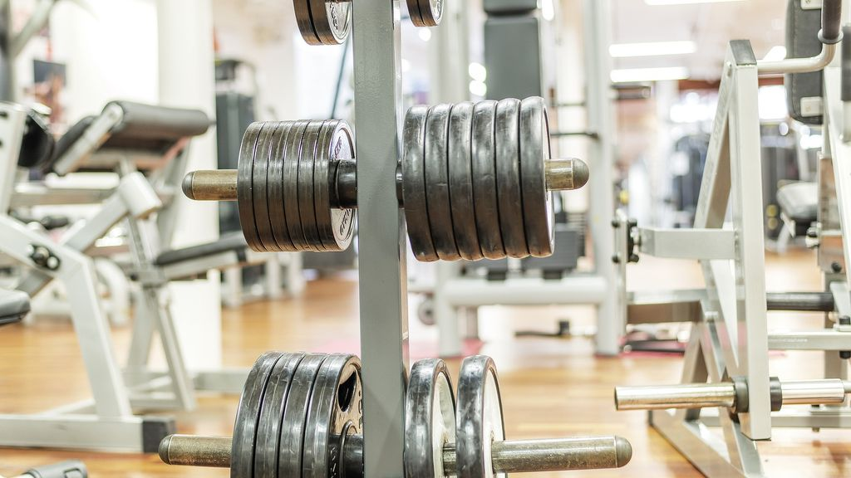
Oportunistic Opening of a new Gym in the Center of NY City
Capstone Project – March 30, 2020

Slide 2
Content
Intro
Restaurants in the Center of NY
‘Bad’ Restaurants in the Center of NY
‘Bad’ Restaurants in the Center – not next to existing Gym
Conclusion and next steps

Slide 3
Intro
For our customer we have to identify possible locations in the center of Manhattan to acquire a building as he plans to open a new gym (his first Gym in NYC - part of expansion strategy).
We were asked to focus on restaurants, as they might get in financial difficulties during the lock-down due to the corona crisis. Especially, we shall focus on ‘bad’ restaurants, as they are more likely to get in difficulties.
Furthermore, we have to identify, whether there are already existing Gyms next to those restaurants.

Slide 4
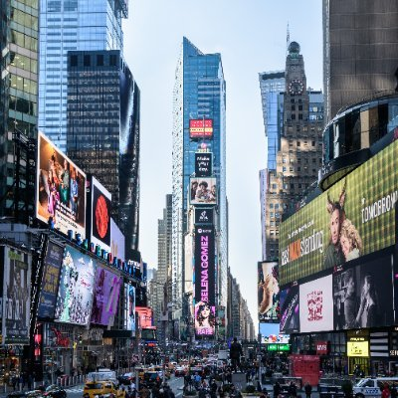
Restaurants in the Center of New York (I)
As agreed the time square was defined as the center of New York
All restaurants in the close area (defined as within a radius of 1000 meters) were identified
Data is based on Foursquare
(The number of restaurants in this analysis was limited as there is limitation to access rating information with a free Foursquare account)

Slide 5
Restaurants in the Center of New York (II)
17 Restaurants were identified
Click on Explorer Icon to see them on the map
By clicking on the restaurant the entry number can be seen (details for each entry are provided in separate list)
(The number of restaurants in this analysis was limited as there is limitation to access rating information with a free Foursquare account)

Slide 6
Bad Restaurants in the Center of NY
9 of the 17 Restaurants were classified as ‘bad’
The mean rating of the restaurants is 7.16
Restaurants with a rating below the mean (rounded 7) or with no rating, were defined as ‘bad’
The Rating is based on Foursquare
By clicking on the restaurant the entry number can be seen (details for each entry are provided in separate list)
(The number of restaurants in this analysis was limited as there is limitation to access rating information with a free Foursquare account)

Slide 7
‘Bad’ Restaurants in the Center – not next to existing Gym
There is a huge density of Gyms in the Center of NY
On average the next Gym is within 57 meters of the restaurants
We defined the minimal required distance to an existing Gym has to be at least 100 meters.
There is only one restaurant left fulfilling this condition!
By clicking on the restaurant the entry number can be seen (details for each entry are provided in separate list)
(The number of restaurants in this analysis was limited as there is limitation to access rating information with a free Foursquare account)

Slide 8
Conclusion / Next Steps
As only 1 Restaurant was identified some rework is required
As a first step a paid Foursquare Account is required to avoid limitation regarding rating information
As a next step the Gyms in the close area of the restaurants could be classified; there might be Gyms that must not be considered as competitors. The categories of the Gyms should be analysed to understand the customer segment.
Furthermore, the radius (currently defined as 1000 meters) of the center could be expanded to identify additional restaurants.

